Slide 1


HOUSE CONSTRUCTION

Slide 2




MEPI
Corporate Profile
EXCLUSIVE CONTRACTORS
Name of Company
MEGAEAST PROPERTIES, INC.
C
O
R
P
O
R
A
T
E
P
R
O
F
I
L
E
Company Address
LEVEL 1, Sta. Lucia East Grand Mall,
Marcos Hi-way, Cainta Rizal
Contact Nos./ Fax No.
681-7459/681-5682
If you want to do it,
Do It - TODAY.
- Jonathan Lockwood Huie

Slide 3
C
O
N
T
R
U
C
T
O
R
S
Arch. Nestor Rey

Slide 4
EXCLUSIVE CONTRACTORS
PERSPECTIVE
A
R
C
H
.
N
E
S
T
O
R
R
E
Y

Slide 5
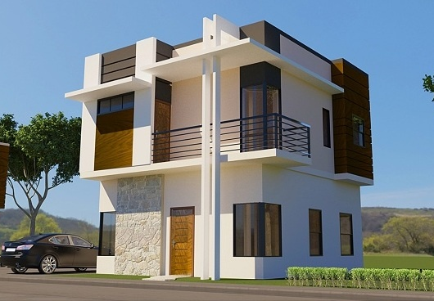
EXCLUSIVE CONTRACTORS
P
E
R
S
P
E
C
T
I
V
E
Elizabeth

Slide 6
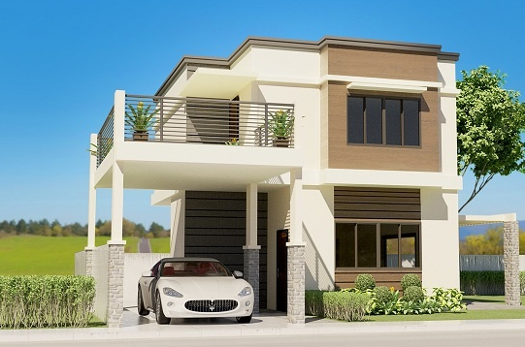
P
E
R
S
P
E
C
T
I
V
E
KENSINGTON

Slide 7
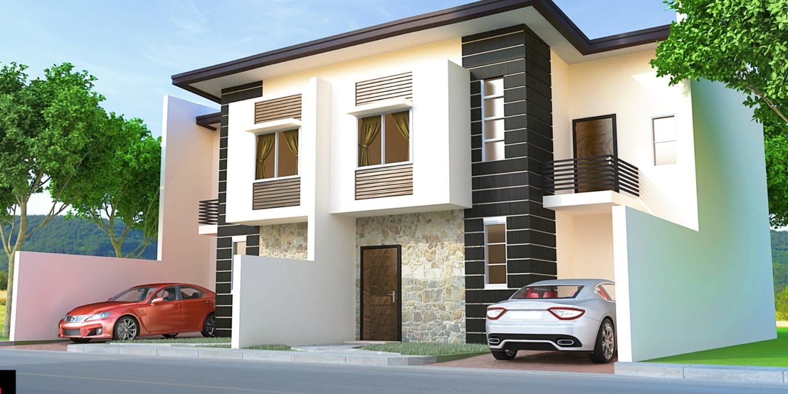
P
E
R
S
P
E
C
T
I
V
E
FIDILLA

Slide 8
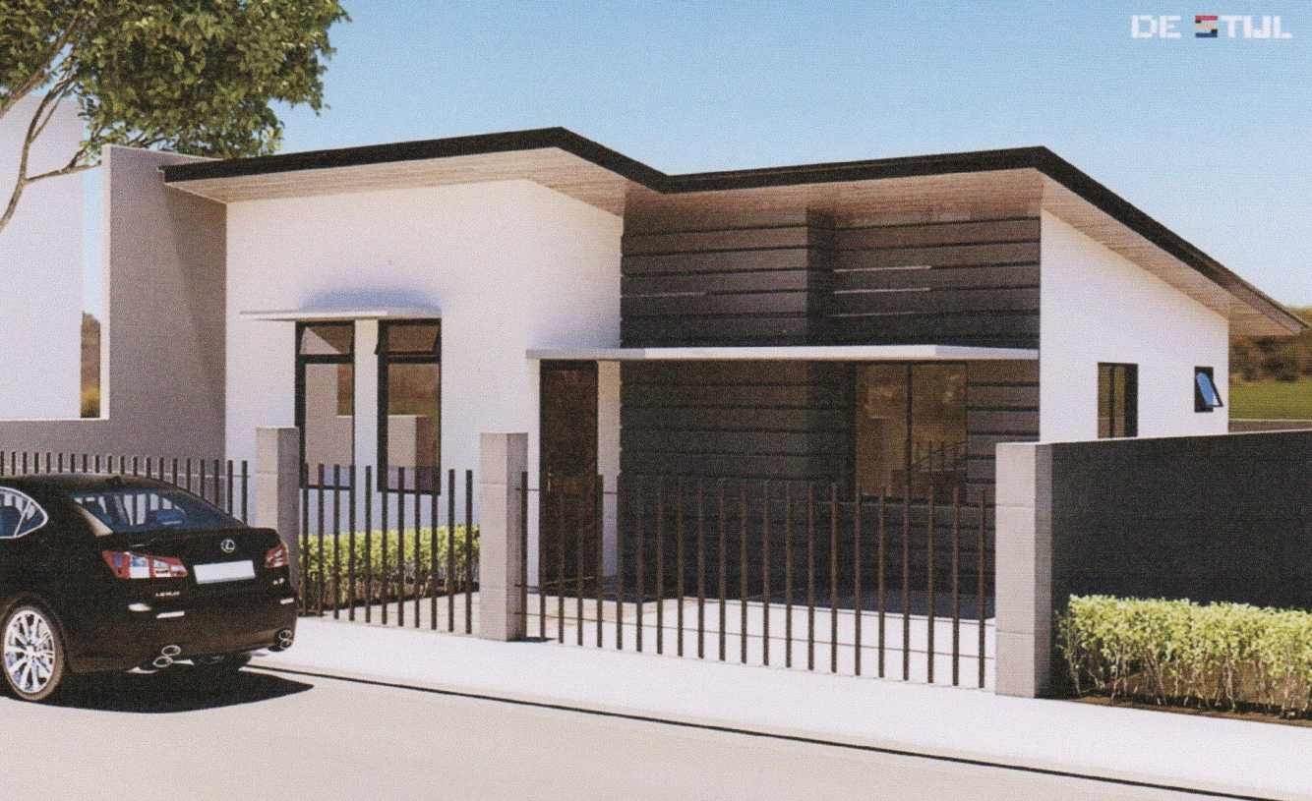
EXCLUSIVE CONTRACTORS
P
E
R
S
P
E
C
T
I
V
E
OXFORD

Slide 9
EXCLUSIVE CONTRACTORS
PERSPECTIVE
E
N
G
R
.
R
E
Y
D
E
L
A
C
R
U
Z

Slide 10
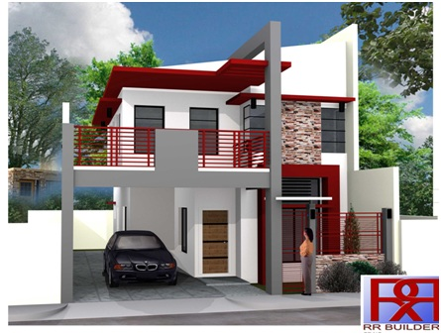
EXCLUSIVE CONTRACTORS
P
E
R
S
P
E
C
T
I
V
E
Rosal

Slide 11
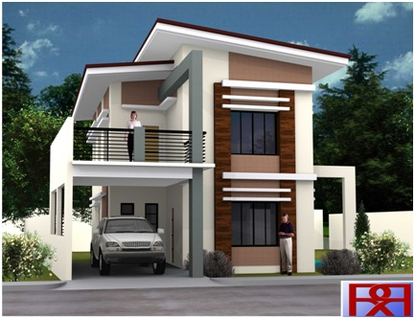
EXCLUSIVE CONTRACTORS
P
E
R
S
P
E
C
T
I
V
E

Slide 12
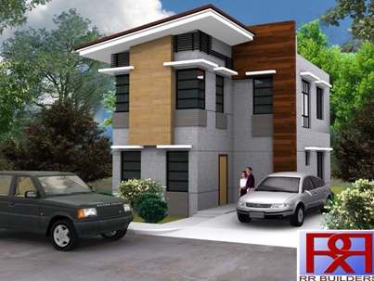
EXCLUSIVE CONTRACTORS
P
E
R
S
P
E
C
T
I
V
E
Palmera

Slide 13
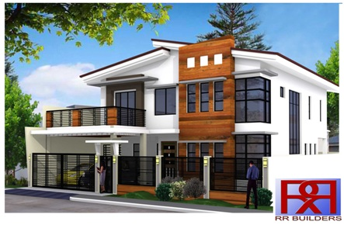
EXCLUSIVE CONTRACTORS
P
E
R
S
P
E
C
T
I
V
E
SAMPAGUITA

Slide 14
Standard
EXCLUSIVE CONTRACTORS
A. Wall Finishes
  Exterior Walls : 5&6”CHB Wall, Plain cement painted finish
  Deco stone or equivalent for decorative wall stone if required but not more than 6sq.m.
  Interior Walls : T&B and Stair 4" CHB Wall;
S
P
E
C
I
F
I
C
A
T
I
O
N

Slide 15
EXCLUSIVE CONTRACTORS
B. Floor Finishes
  Living, Dining, Kitchen & Maids Room 40x40cm Ceramic Floor tiles w/ ABC grout or equal
  Ground Floor toilet and bath use 30x30cm ceramic floor unglazed tile 20x30cm ceramic wall glazed tiles ( 160 cm. height)
  Kitchen counter top use salt and paper (china) granite slab with 50x70cm polar stainless sink w/ swan type faucet
S
P
E
C
I
F
I
C
A
T
I
O
N

Slide 16
EXCLUSIVE CONTRACTORS
  Second Second floor toilet and bath use 30x30cm ceramic unglazed floor tile 30x30cm ceramic wall glazed tile w/ ABC grout or equal
  Bedroom & Hallway use 40x40cm ceramic floor tile
  Carport, Lanai & Laundry Plain cement with groove design
  Balcony, use 30x30cm Outdoor ceramic tile w/ ABC grout or equal
S
P
E
C
I
F
I
C
A
T
I
O
N

Slide 17
EXCLUSIVE CONTRACTORS
C. Roofing
  PUYAT or Union steel .4mm pre-painted Rib type long span roofing with 5mm 1 side insulation and box type 24" gutter w/ 2" steel tekscrew
  Steel trusses use 3/16x2" top and bottom chord and 3/16x11/2" member Angle bar and 2x3“ x1.2mm purlins and 2x6“ x 1.2mm purlins for facia board w/ red oxide primer/epoxy primer
S
P
E
C
I
F
I
C
A
T
I
O
N

Slide 18
EXCLUSIVE CONTRACTORS
F. Kitchen and Bedroom Cabinet
  Use ¾”Plyboard w/ 6"stainless cabinet with Handle and systema or amerilock concelled hinges duco varnish finish w/ 1/2“ conduit pipe for hanger rod
  For kitchen cabinet w/ 3"pvc pipe provision for range hood
S
P
E
C
I
F
I
C
A
T
I
O
N

Slide 19
G. Toilet Fixtures
  GF and 2F common T&B, use Pozzi brand water closet, lavatory w/ pedestal and accessories w/ soap and tissue paper holder
  Master toilet and bath, use Pozzi brand dual flush water closet w/ basin type lavatory, soap and tissue paper holder accessories
  Clear tempered glass sliding shower enclosure w/ telephone shower and provision for water heater line
EXCLUSIVE CONTRACTORS
S
P
E
C
I
F
I
C
A
T
I
O
N

Slide 20
H. Electrical, Lighting Fixtures, Devices
  4” Ø pinlight (fiam) with incandescent bulb socket (no bulbs) Living & Master BR only
  Switches and outlet Royu brand wide series type or equivalent
  Lighting wire use 2.0mm THHN wire w/ 25mm mould flex
EXCLUSIVE CONTRACTORS
S
P
E
C
I
F
I
C
A
T
I
O
N

Slide 21
  Outlet 3.5mm THHN wire w/ 25mm mould flex
  Main Line 8.0mm THHN wire w/ 32mm emerald pvc pipe
  Safety breaker and panel box
  Telephone and cable (RG6) outlet for living and master bedroom
  PVC utility and junction boxes
EXCLUSIVE CONTRACTORS
S
P
E
C
I
F
I
C
A
T
I
O
N

Slide 22
I. Plumbing and sanitary
  Water line use moldex pvc pipe w/ neltex cement adhesive
  Drainage line and down spout use emerald pvc pipe w/ neltex cement adhesive
EXCLUSIVE CONTRACTORS
S
P
E
C
I
F
I
C
A
T
I
O
N

Slide 23
  Water heater pipe line use exemplas brand w/ stainless fittings
  Sewer line use emerald pvc pipe
  Floor drain use stainless 4x4"
  Catch basin floor drain use 8” x 8” CI strainer
EXCLUSIVE CONTRACTORS
S
P
E
C
I
F
I
C
A
T
I
O
N

Slide 24
J. Painting Works
  Preparation boysen concrete neutralizer
  Exterior wall use boysen flat latex primer and rain or shine elastomeric finish
  Interior wall use rain or shine elastomeric paint, pre-mixed color
EXCLUSIVE CONTRACTORS
S
P
E
C
I
F
I
C
A
T
I
O
N

Slide 25
  Exterior and T&B ceiling use boysen flat latex
  Interior ceiling use boysen flat latex paint
  Door, cabinets, cornice and base board use wood stain mahogany duco varnish finish
EXCLUSIVE CONTRACTORS
S
P
E
C
I
F
I
C
A
T
I
O
N

Slide 26
EXCLUSIVE CONTRACTORS
  Fire wall, use flexibond or water pipe w/ elastomeric paint for water proofing
  Gate, window grilles use red oxide primer and boysen chocolate brown paint
  T&B and balcony slabs water proofing use thoroseal or Pioneer watertite 103
S
P
E
C
I
F
I
C
A
T
I
O
N

Slide 27
PRICE
BASED ON FLOOR AREA
EXCLUSIVE CONTRACTORS
STANDARD | PHP. 25,000.00/SQ.M
 | BELOW SPECS | ABOVE SPECS
OWNER’S SPECS | COST ESTIMATE | P 26,000.00 and above
C
O
S
T
I
N
G
RESERVATION FEE | P 50,000.00

Slide 28
EXCLUSIVE CONTRACTORS
BANK FINANCING
  30 % Downpayment
  70% Loan proceeds
STRAIGHT CONTRACT
  30% Downpayment
  30% Upon 40% completion
  30% Upon 80% completion
  10% Upon Turn Over
T
E
R
M
S
O
F
P
A
Y
M
E
N
T

Slide 29
EXCLUSIVE CONTRACTORS
OUR PROJECT
ACCOMPLISHMENT
P
R
O
J
E
C
T
S

Slide 30
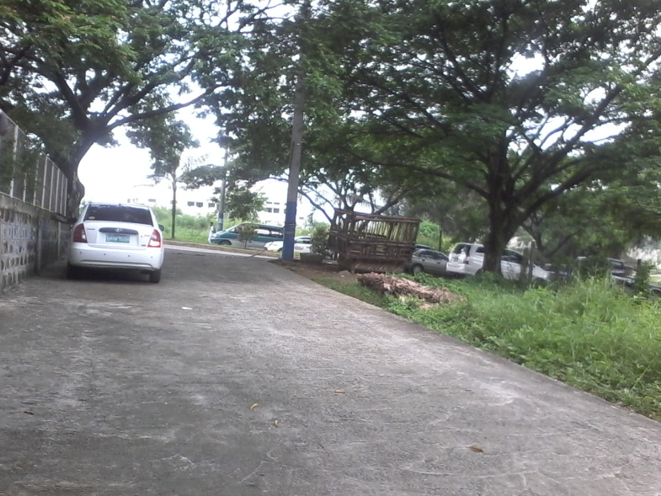
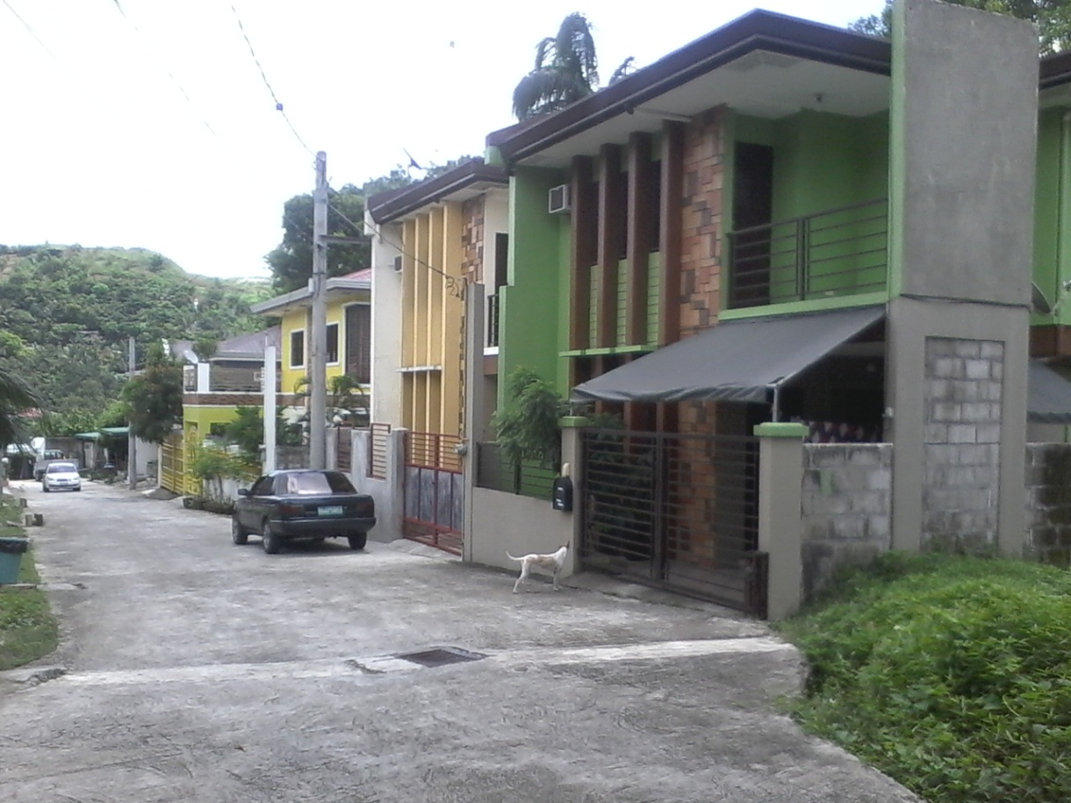
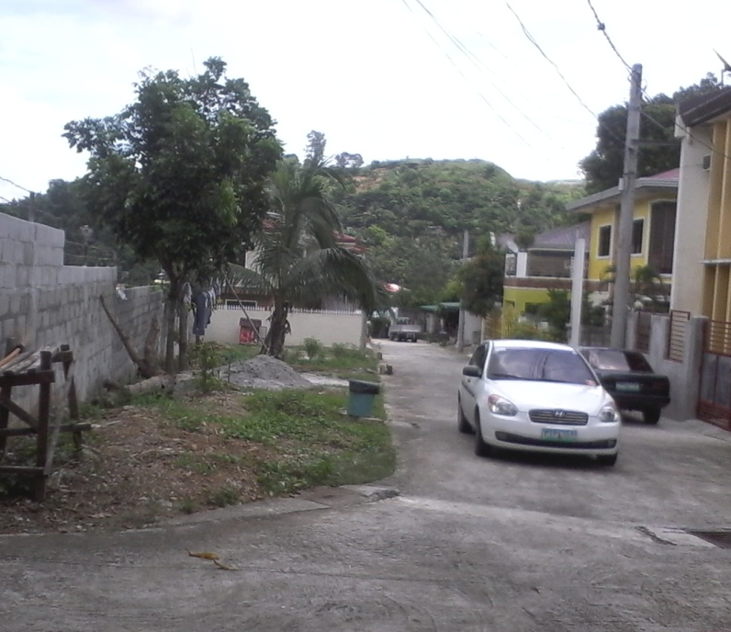
Ginza Residences
Blue Mountain, Antipolo City
EXCLUSIVE CONTRACTORS
P
R
O
J
E
C
T
S

Slide 31
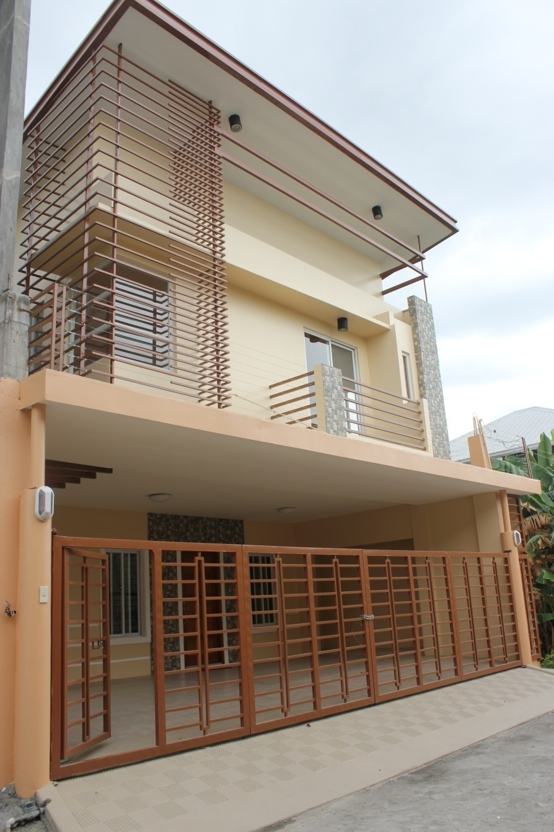
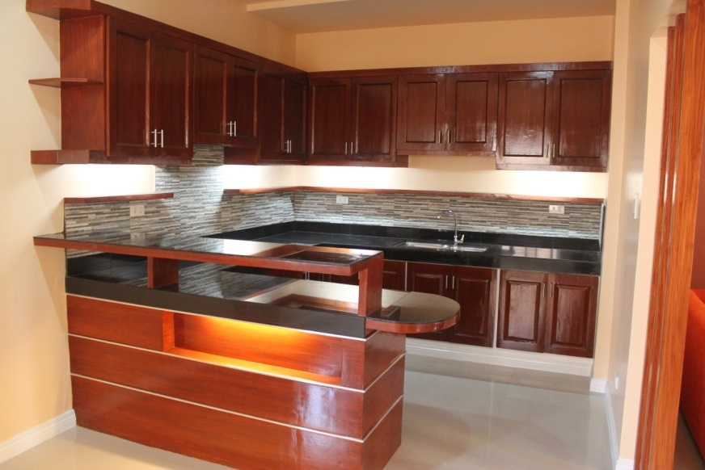
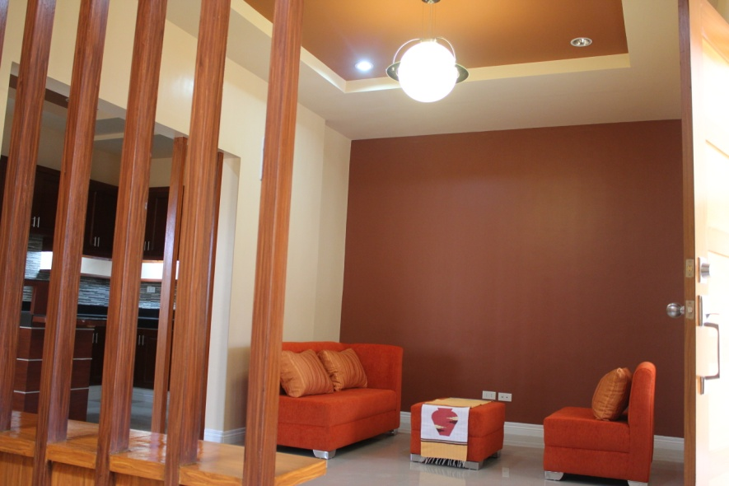
Vermont Ginza Residences
Mayamot, Anitpolo City
EXCLUSIVE CONTRACTORS
P
R
O
J
E
C
T
S

Slide 32
Village East Ginza Residences
Village East Homes, Cainta Rizal
EXCLUSIVE CONTRACTORS
P
R
O
J
E
C
T
S

Slide 33
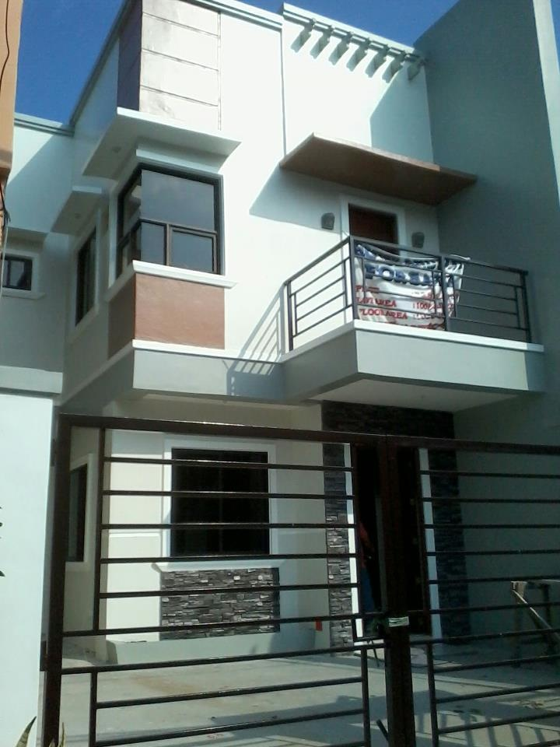
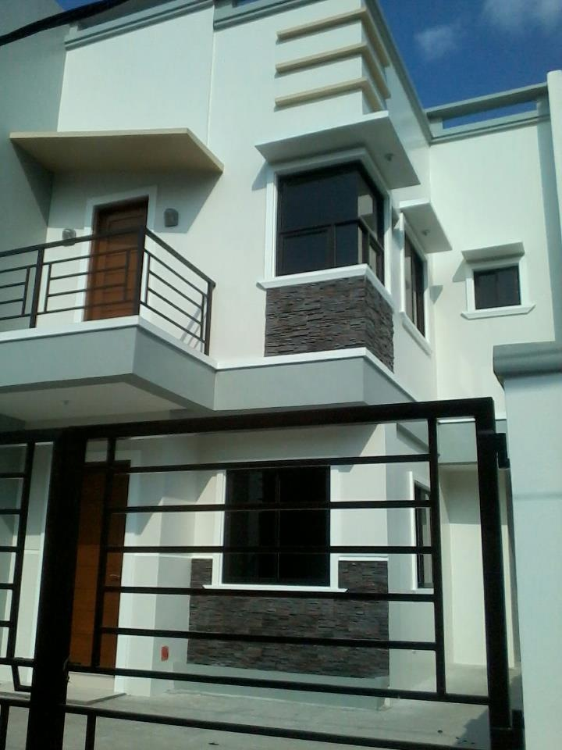
Vista Verde Ginza Residences
Felix Avenue, Cainta Rizal
EXCLUSIVE CONTRACTORS
P
R
O
J
E
C
T
S

Slide 34
MONTEVERDE ROYALE
Block 8 Lot 15 Phase 3-A
EXCLUSIVE CONTRACTORS
P
R
O
J
E
C
T
S

Slide 35
EXCLUSIVE CONTRACTORS
ON GOING
PROJECTS
O
N
G
O
I
N
G
P
R
O
J
E
C
T
S

Slide 36
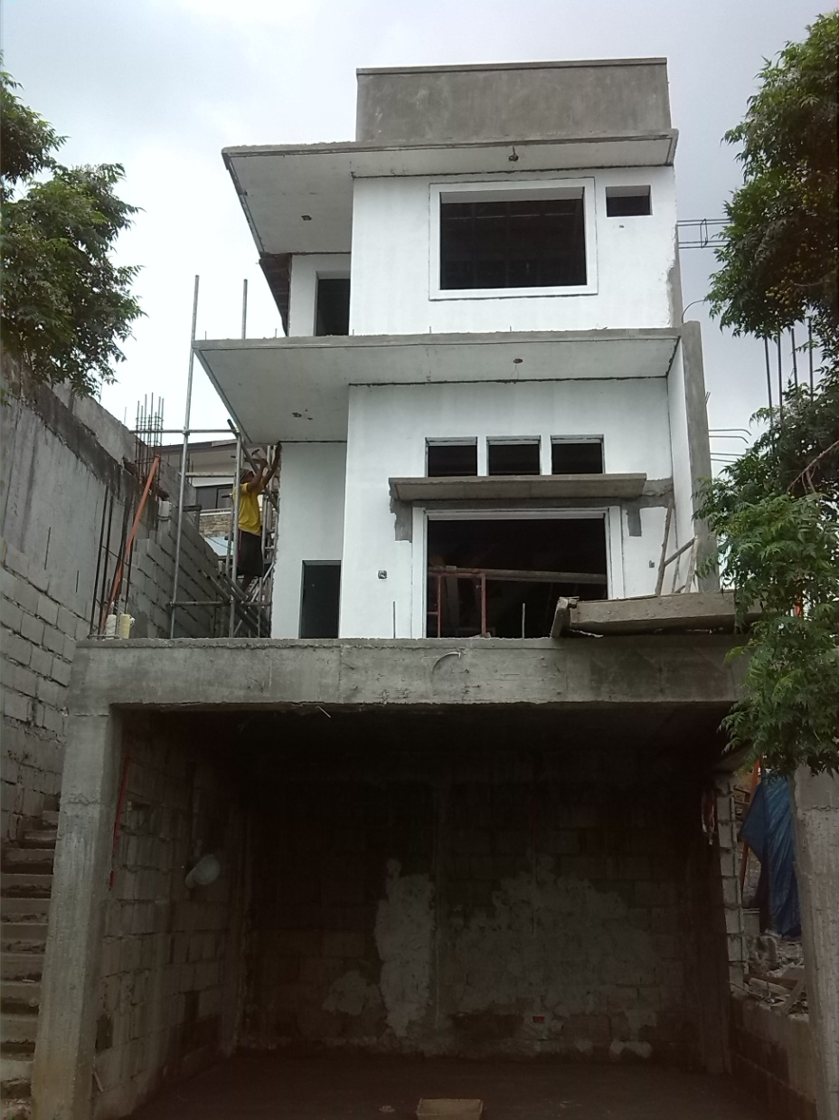
MONTEVERDE ROYALE
Blk. 8 Lot 15 Phase 3-a
EXCLUSIVE CONTRACTORS
Lot Area : 232 sq.m
Floor Area : 135 sq.m
Unit Price
P 3,240,000.00
O
N
G
O
I
N
G
P
R
O
J
E
C
T
S

Slide 37
Village east ginza
Lot 2 Cougar St., Village East Homes, Cainta Rizal
EXCLUSIVE CONTRACTORS
Lot Area : 70sq.m
Floor Area: 117sq.m
Unit Price
P 3,381,800.00
O
N
G
O
I
N
G
P
R
O
J
E
C
T
S

Slide 38
EXCLUSIVE CONTRACTORS
Title
Lot Plan
Certification from Surveyor
2 Valid ID’s
2 Billing Address
Marriage Contract
SPA
Approved Plan from the Developer
Meralco & Water Connection
Construction Permit from Developer
Construction Permit from Homes Owners Association
Authorization Letter to construct
R
E
Q
U
I
E
R
M
E
N
T
S

Slide 39
EXCLUSIVE CONTRACTORS
Start of the construction upon
30% downpayment of TCP
Approved Plan and Permits
Approved Letter of Guarantee from
Bank Financing
Max. Construction ( 180) days or
6 Months
P
R
O
C
E
D
U
R
E
S

Slide 40
EXCLUSIVE CONTRACTORS
12 months Warranty from date of House Acceptance
    Structural Damages such Crack
    Water Leak from Pipeline and Roofing
    Electrical Malfunction
Note : Additional work without consent from MEPI is not included for the house warranty.
W
A
R
R
A
N
T
Y

Slide 41
EXCLUSIVE CONTRACTORS
God Bless &
Happy Selling !!!

